Slide 1
Predicting Employee Attrition Using Machine Learning

Slide 2
Predicting Employee Attrition Using Machine Learning
Employee attrition is a critical organizational challenge.
Impacts include increased recruitment and training costs, productivity loss.
Objective: Predict attrition using machine learning.
Business Goals:
Reduce turnover with early interventions.
Understand attrition drivers (job satisfaction, compensation, etc.).
Support data-driven HR decisions.

Slide 3
CRISP-DM Methodology
Business Understanding: Align objectives with goals.
Data Understanding: Analyze 1470 records, 35 features.
Data Preparation: Clean, encode, normalize, and balance data.
Modeling: Apply machine learning models.
Evaluation: Assess performance metrics.
Deployment: Integrate results into HR workflows.

Slide 4
Data Understanding
Dataset: 1470 records, 35 attributes (demographics, roles, compensation, etc.).
Class Imbalance:
Yes (Attrition): 237 (16.1%).
No (Retention): 1233 (83.9%).
Key Factors:
Younger employees have higher attrition.
Frequent business travel and overtime increase attrition.
Lower income and longer commutes correlate with higher attrition.

Slide 5
Data Preparation
Missing Data: No null values detected.
Encoding: Categorical variables transformed (e.g., one-hot encoding).
Normalization: Scaled numerical attributes (Age, Income).
Class Balancing: Handled imbalance via evaluation metrics and sampling.
Feature Selection: Removed irrelevant features (e.g., EmployeeCount).
Dataset Split: 80% training, 20% testing, stratified.

Slide 6
Modeling Process
Models Used:
Logistic Regression, Random Forest, Decision Tree.
Support Vector Machine (SVM), k-Nearest Neighbors (kNN).
Neural Networks.
Evaluation Metrics:
Accuracy, Precision, Recall, F1-Score, ROC-AUC.
Best Models:
Logistic Regression: Balanced metrics and interpretability.
Random Forest: High accuracy and robustness.

Slide 7
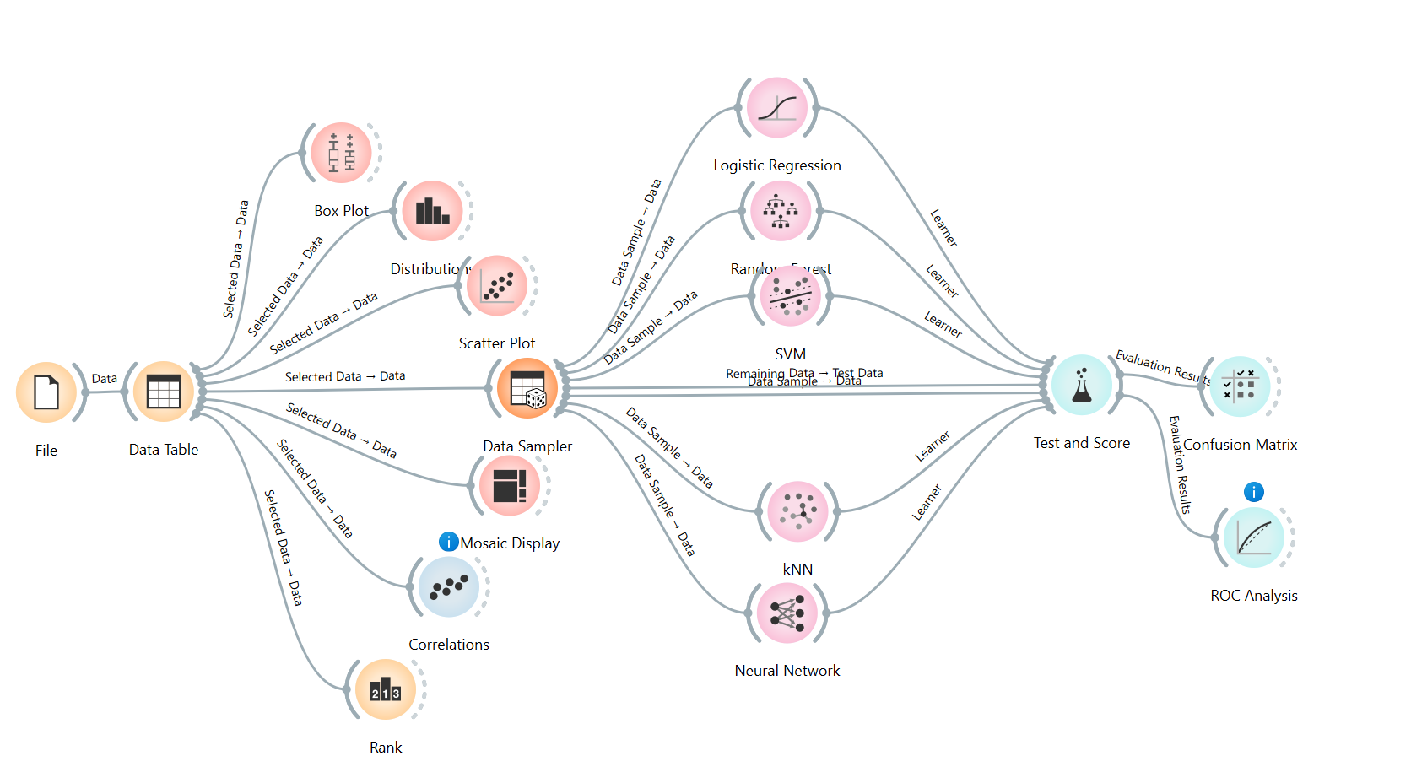
Modeling Processing

Slide 8
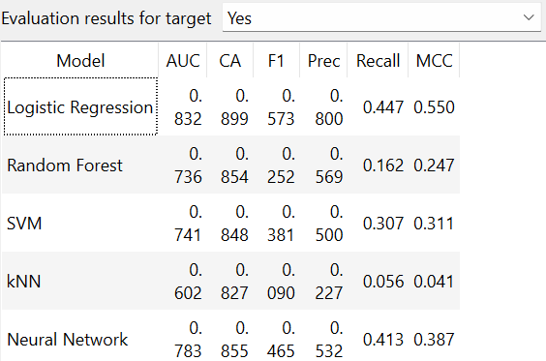
Results from Modeling

Slide 9
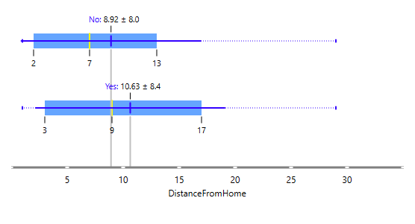
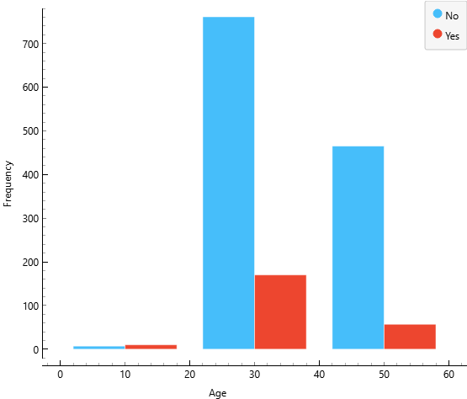
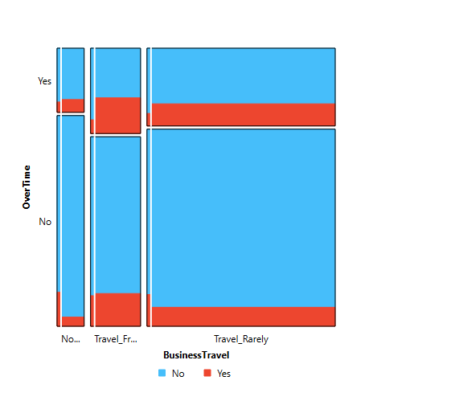
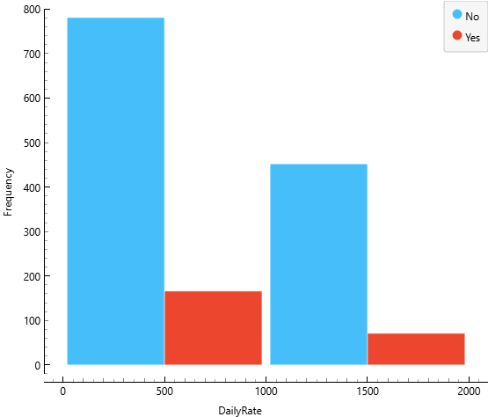
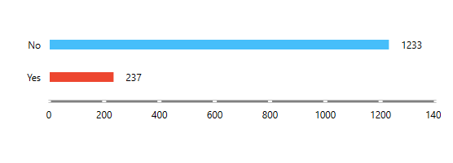
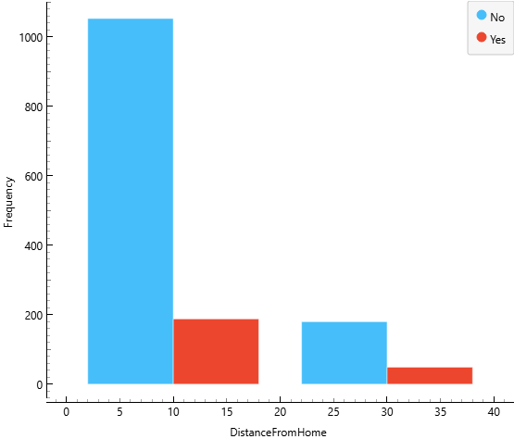
Data Visualization

Slide 10
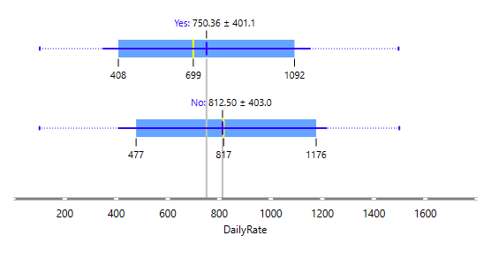
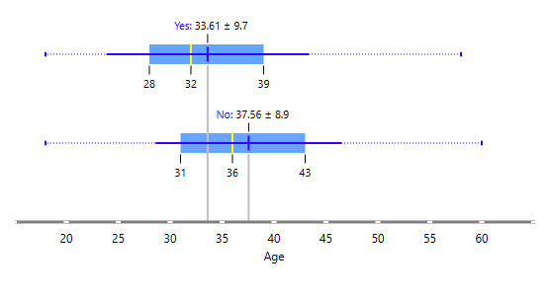
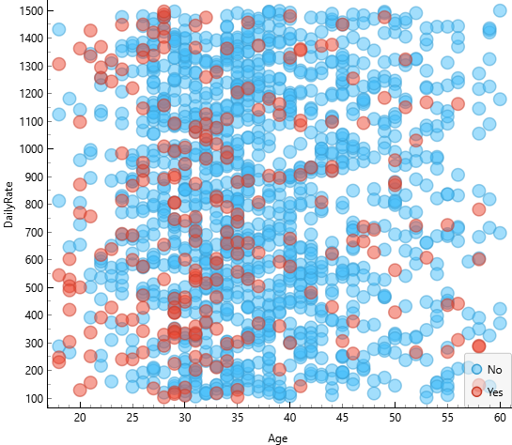

Slide 11
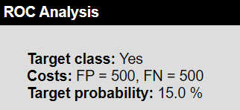
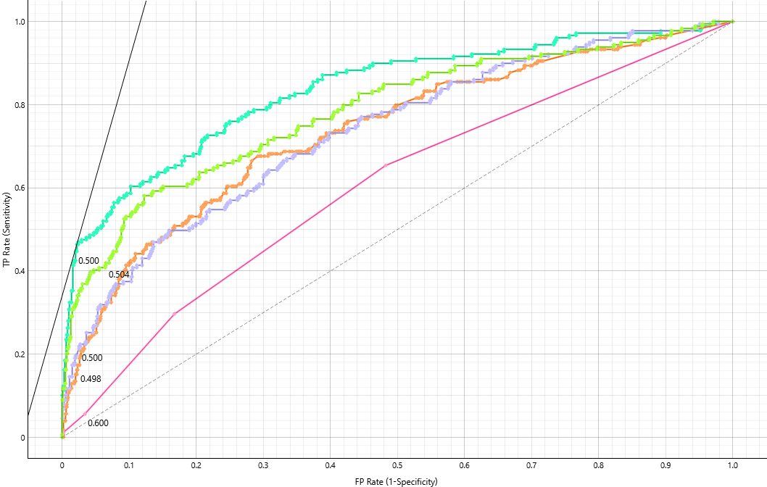
ROC Analysis

Slide 12
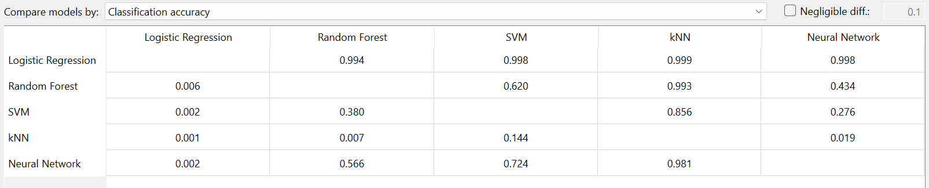
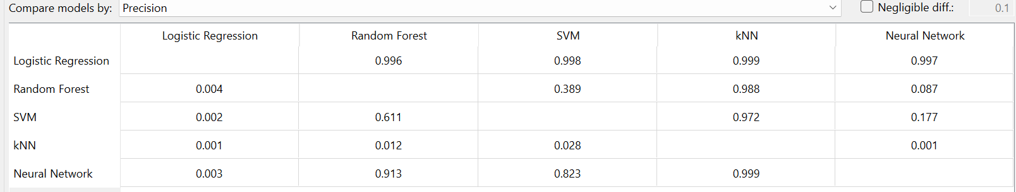
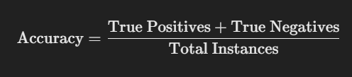

Training Set and Testing
Accuracy
Precision

Slide 13
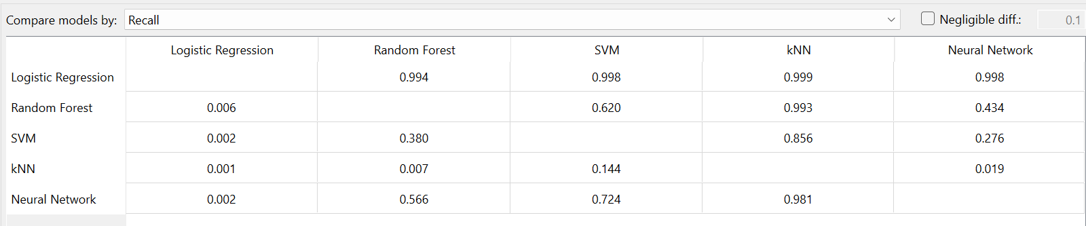
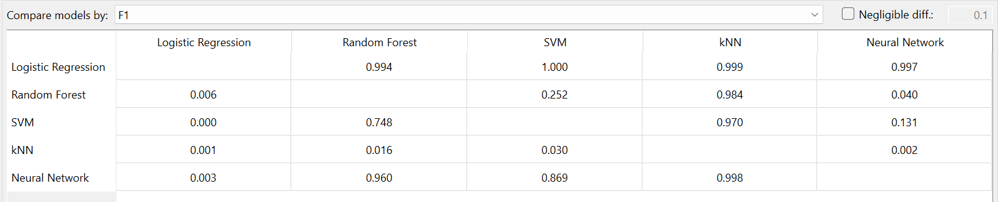
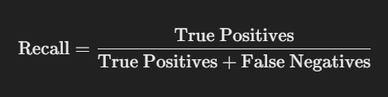

Training Set and Testing
Recall
F1-Score

Slide 14
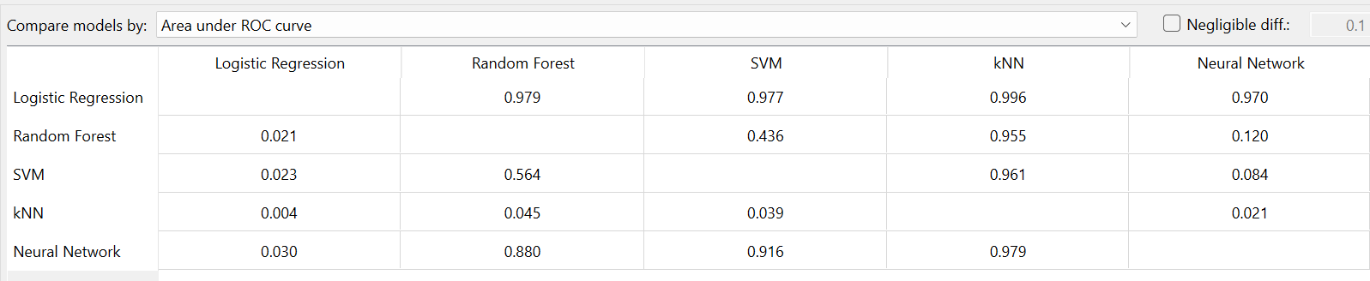
Training Set and Testing
ROC-AUC
(Receiver Operating Characteristic - Area Under Curve)

Slide 15
Confusion Matrix
The Confusion Matrix is a performance evaluation tool that provides a summary of the classification results for a machine learning model. It allows us to assess how well the model predicts the target class, particularly for a binary classification task such as Employee Attrition (Yes/No).

Slide 16
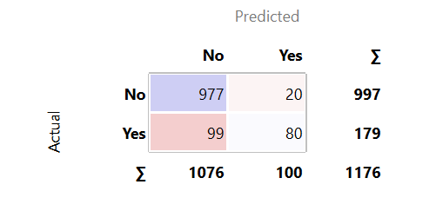
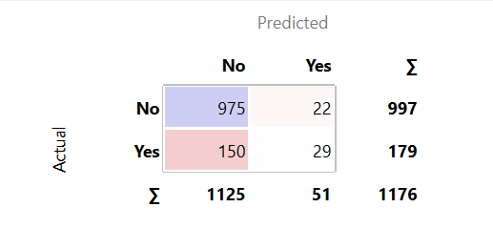
Confusion Matrix
Logistic Regression
Random Forest

Slide 17
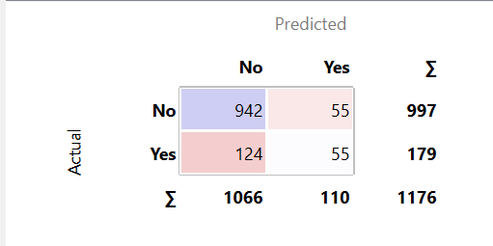
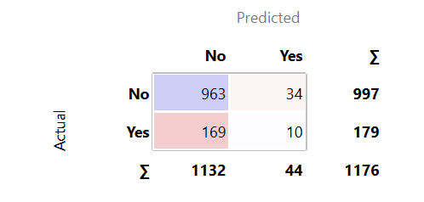
Confusion Matrix
SVM
KNN

Slide 18
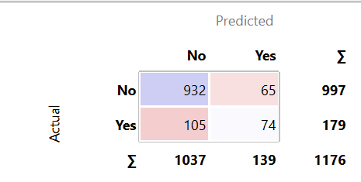
Confusion Matrix
Neural Network

Slide 19
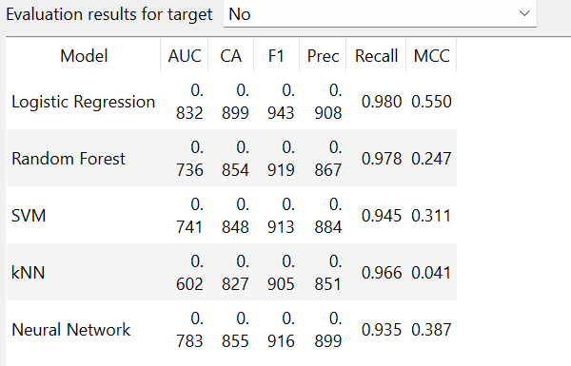
Reference Screen Shots

Slide 20
Evaluation Results
Performance of Models:
Logistic Regression: AUC 0.83, Accuracy 83%.
Random Forest: AUC 0.88, Accuracy 86%.
Neural Networks: AUC 0.87, Accuracy 85%.
Best Model: Logistic Regression
High precision, balanced recall, interpretability.

Slide 21
Deployment
Steps:
Deploy Logistic Regression for HR workflows.
Input: Employee data (e.g., Age, Income, Over Time).
Output: Attrition prediction (Yes/No), risk score, key factors.
Benefits:
Early intervention for high-risk employees.
Data-driven HR strategies to improve retention.
Regular model monitoring and updates.

Slide 22
Conclusion
Successful development of a predictive system for attrition.
Logistic Regression is ideal for deployment due to interpretability and performance.
Empowers HR teams to proactively address attrition and improve employee retention.
Refer documentation for more information

Slide 23
References
Dataset source: Kaggle(https://www.kaggle.com/datasets/patelprashant/employee-attrition)
Daniel T. Larose-Discovering Knowledge in Data_ An Introduction to Data Mining-Wiley-Interscience
https://sit.instructure.com/courses/74412/files/13748864?module_item_id=2257740
https://sit.instructure.com/courses/74412/files/13749404?module_item_id=2257744

